Slide 1
Big O and Complexity
Dilipkumar S.

Slide 2
Content
Asymptotic notation
Order of Growth
Calculation of time complexity
  Non-recursive function
  Recursive function
Complexity for sorting and searching algorithms

Slide 3
Analysis framework
Computing best,worst and average case efficiencies
Measuring
Space complexity
Measuring input size
Analysis Frame work
Measuring
time complexity
Measuring running
time
Computing order of growth of Algorithm

Slide 4
Order of Growth

Slide 5
Value | logn | n | nlogn | n^2 | n^3 | 2^n | n!
1 | 0 | 1 | 0 | 1 | 1 | 2 | 1
2 | 1 | 2 | 2 | 4 | 8 | 4 | 2
4 | 2 | 4 | 8 | 16 | 64 | 16 | 24
8 | 3 | 8 | 24 | 64 | 512 | 256 | 40320
16 | 4 | 16 | 64 | 256 | 4096 | 65536 | 2.6*10^48
10 | 3.2 | 10 | 3.3*10 | 10^2 | 10^3 | 10^3 | 3.6*10^6
10^2 | 6.6 | 10^2 | 6.6*10^2 | 10^4 | 10^6 | 1.3*10^30 | 9.3*10^157
10^3 | 10 | 10^3 | 1.0*10^4 | 10^6 | 10^9 | high | high

Slide 6
Asymptotic Notation

Slide 7
What is Asymptotic Notation ?
Asymptotic Notations of a function is the study of how the value of the function varies for large values of n, where n is the size of input.
Using Asymptotic notation we could easily find the efficiency of the algorithm.

Slide 8
Types of Asymptotic notation
Three different type of asymptotic notation
  O (Big Oh)
  Ω (Big Omega)
  Θ (Big Theta)

Slide 9
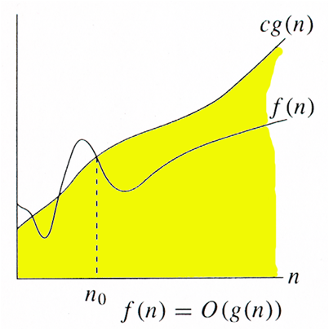
  O (Big Oh)
Upper bound of algorithm's running time.
Worst case running time for an algorithm
Longest amount of time the algorithm takes to compute.
f(n) ≤ c*g(n) for all n ≥ n0.
or
f(n) Є O(g(n))
Upper bound

Slide 10
Formal definition
A function f(n) is said to be in O(g(n)), denoted by f(n) ∈ O(g(n)), if f(n) is bounded above by some constant multiple of g(n) for all large n,
i.e., if there exist some positive constant c and some non-negative integer n0 such that
f(n) ≤ c * g(n) for all n ≥ n0.

Slide 11
Examples for Big- O
1. fn() = 100n + 5
  Let c * g(n) = 100n + n (replacing constant 5 with n )
  ie c * g(n) = 101n
  since f(n) <= c * g(n)
  100n + 5 <= 101n for all n >= 5
  so c = 101 g(n) = n n0 = 5
Hence f(n) ≤ c * g(n) for all n ≥ n0
f(n) Є O(g(n))

Slide 12
Cont....
f(n) = 3n + 2
Ans: 3n + 2 <= 4n
f(n) = 10n^3 + 8
Ans: 10n^3 <= 11n^3
f(n) = 10n^2 + 4n + 2
Ans: 10n^2 + 4n + 2 <= 11n^2

Slide 13
  Ω (Big Omega)
Lower bound of algorithm's running time.
Best case running time for an algorithm.
Gives minimum amount of time the algorithm takes to compute.
f(n) > = c * g(n) for all n >= n0
f(n) Ω (g(n))

Slide 14
Examples for Big- Ω
1. fn() = 100n + 5
  Let c * g(n) = 100n (Discarding constant 5)
  ie c * g(n) = 100n
  since f(n) >= c * g(n)
  100n + 5 >= 100n for all n >= 0
  so c = 100 g(n) = n n0 = 0
Hence f(n) >= c * g(n) for all n ≥ n0
f(n) Є Ω(g(n))

Slide 15
Cont....
f(n) = 50n + 6
Ans: 50n
f(n) = 17n^3 + 5
Ans: 17n^3

Slide 16
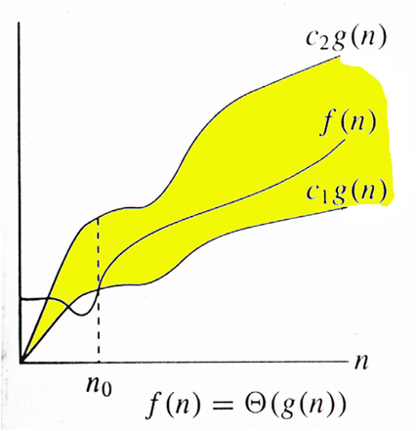
  Θ (Big Theta)
Gives average amount of time the algorithm takes to compute.
c1 * g(n) <= f(n) <= c2 * g(n)
for all n >= n0
f(n) Θ (g(n))

Slide 17
Examples for Big- Θ
1. fn() = 10n^3 + 5
  Let c2 * g(n) = 10n^3 + n (replacing constant 5 with n )
  ie c2 * g(n) = 11n^3
  Let c1 * g(n) = 10n^3
  since c1 * g(n) <= f(n) <= c2 * g(n)
  10n^3 <= 10n^3 +5 <= 11n^3
  so c1 = 10n^3, c2 = 11n^3, g(n) = n^3, n0 = 2
f(n) Є Θ(g(n))

Slide 18
General plan for Analyzing the Time Efficiency of Non-recursive Algorithm
Based on input determine the number of parameters to be considered.
Identify the algorithms basic operation.
Check the basic operation depends only on the size of the input.
Obtain the total number times to basic operation is executed.
An useful formula to compute is

Slide 19
Matrix multiplication
for i ← 0 to n - 1 do
  for j ← 0 to n - 1 do
    c[j] ← 0
    for k ← 0 to n - 1 do
      c[i,j] ← c[i,j] + A[i,k] * B[k,j]
Basic operation
T(n) = Θ(n^3)

Slide 20
General plan for Analyzing the Time Efficiency of recursive Algorithm
Based on input determine the number of parameters to be considered.
Identify the algorithms basic operation.
Check the basic operation depends only on the size of the input.
Set up a recurrence relation with an appropriate initial condition, for number of times the basic operation is executed.

Slide 21
Example: 1
Recursive algorithm to find factorial of a number
Factorial(int n){
  if (n == 0)
return 1;
return (Factorial(n – 1) * n);
}

Slide 22
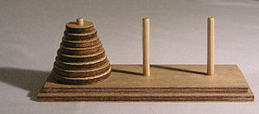
Example: 2
Tower of Hanoi

Slide 23
Algorithm
Tower_honai(n, source, temp, dest)
Step 1: If( n == 1)
move(n'st, source, dest)
return
Step 2: Tower_honai(n - 1, source, dest, temp)
Step 3: move(nth, source, dest)
Step 3: Tower_honai(n - 1, temp, dest, source)

Slide 24
The Algorithm - details
BubbleSort(A[0..n-1])
for i <- 0 to n–2 do
for j <- 0 to n-2-i do
if A[j+1] < A[j]
swap A[j] and A[j+1]

Slide 25
The Algorithm - details
SelectionSort(A[0..n-1])
for i <- 0 to n–2 do
  min <- i
    for j <- i+1 to n-1 do
    if A[j] > A[min] min <- j
  swap A[i] and A[min]

Slide 26
The Algorithm - details
InsertionSort(A[0..n-1])
for i <- 0 to n–2 do {
    v <- a[i];
    j<- i – 1;
    while( j >= 0 and A[j] > v) do{
        A[j+1] <- A[j];
        j<- j – 1;
    }
    A[j+1] <- v;
}

Slide 27
Merge sort
mergesort (A , p , r ) - T(n)
if( p > r) return
q = (p+r)/2
mergesort(B , p , q) – T(n/2)
mergesort(C , q+1 , r)– T(n/2)
merge(A, B, C) – (n)
Efficiency
T(n) = T(n/2) + T(n/2) + (n)
T(n) = 2T(n/2) + (n)
T(n) = (n Log (n))

Slide 28
Comparison between various sorting algorithms
Sorting Algorithm | Best | Average | worst
Bubble sort | Ω(n^2) | θ(n^2) | O(n^2)
Insertion sort | Ω(n) | θ(n^2) | O(n^2)
Selection sort | Ω(n^2) | θ(n^2) | O(n^2)
Heap sort | Ω(n*log(n)) | θ(n*log(n)) | O(n*log(n))
Merge sort | Ω(n*log(n)) | θ(n*log(n)) | O(n*log(n))
Quick sort | Ω(n*log(n)) | θ(n*log(n)) | O(n^2)

Slide 29
References
The Design and Analysis of Algorithms by Anany Levitin

